Slide 1
Single Photon Imaging
Siyuan Shen

Slide 2

What CVers are used to
Camera
Notes:
What are they used for

Slide 3

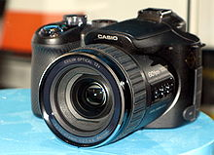
What CVers are used to
ToF camera
1）160 frames per second
2）centimeters – meters
3）X00 dollars
High-speed camera
1）X000 frames per second
2）X0000 dollars
Notes:
What are they used for

Slide 4
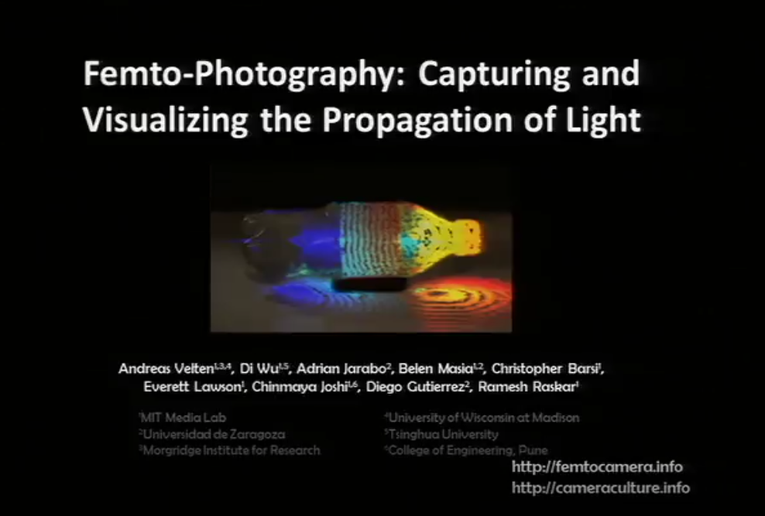
Where all things get started
[1] Velten, Andreas, et al. "Femto-photography: capturing and visualizing the propagation of light." ACM Transactions on Graphics (ToG) 32.4 (2013): 1-8.
Notes:
量子力学与相对论

Slide 5
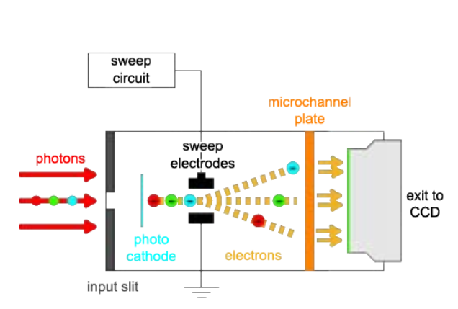
Streak camera
Notes:
光电条纹相机的工作原理是将光照到光电阴极上，当光电阴极被光子击中时通过光电效应产生电子。电子在阴极射线管中被加速，并通过由一对板产生的电场，使电子向侧面偏转。通过调节两块板之间的电动势，电场被迅速改变，使电子产生时间变化的偏转，使电子在管子末端的荧光屏上扫过。
在条纹传感器中，一个光电阴极将从扫描线的每个空间位置进入的光子转换为电子。条纹传感器根据这些电子到达的时间，将其偏转到传感器T维的不同位置，从而生成X-T图像。抵达的时间，将这些电子反射到传感器T维度上的不同位置（见图2（b）和2（c））。这是通过快速改变电极之间的扫描电压来实现的。改变传感器中电极之间的扫描电压。对于每个水平扫描线，相机记录了一个由脉冲照射的场景，并对4:5 × 108个脉冲散射的光进行了平均。脉冲（见图2（d）和2（e））。

Slide 6
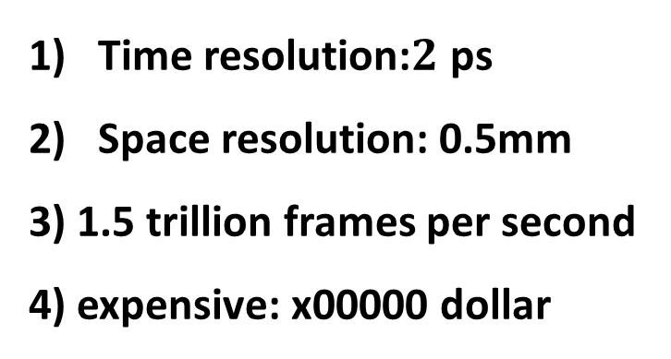
Streak camera
Time resolution:$2$ ps
Space resolution: 0.5mm
3) 1.5 trillion frames per second
4) expensive: x00000 dollar
Notes:
光电条纹相机的工作原理是将光照到光电阴极上，当光电阴极被光子击中时通过光电效应产生电子。电子在阴极射线管中被加速，并通过由一对板产生的电场，使电子向侧面偏转。通过调节两块板之间的电动势，电场被迅速改变，使电子产生时间变化的偏转，使电子在管子末端的荧光屏上扫过。
在条纹传感器中，一个光电阴极将从扫描线的每个空间位置进入的光子转换为电子。条纹传感器根据这些电子到达的时间，将其偏转到传感器T维的不同位置，从而生成X-T图像。抵达的时间，将这些电子反射到传感器T维度上的不同位置（见图2（b）和2（c））。这是通过快速改变电极之间的扫描电压来实现的。改变传感器中电极之间的扫描电压。对于每个水平扫描线，相机记录了一个由脉冲照射的场景，并对4:5 × 108个脉冲散射的光进行了平均。脉冲（见图2（d）和2（e））。

Slide 7
Femto-photography
Challenges:
Low signal-to-noise (SNR) ratio.
Direct measurements of events appear warped in space-time.
Notes:
首先，对于一个未放大的激光脉冲，单次曝光时间小于2ps将无法收集足够的光。的时间将无法收集到足够的光，因此信噪比 将是不可行的低。举例来说，对于一个由100W灯泡照明的桌面场景 为例，对于一个由100W灯泡照亮的桌面场景，在2ps的开放时间内，平均只有约1个光子到达传感器。在2ps的开放快门期间到达传感器。

Slide 8
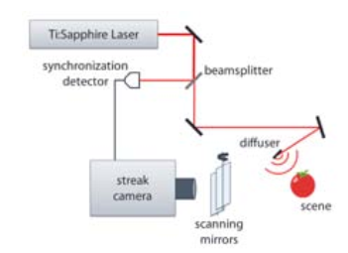
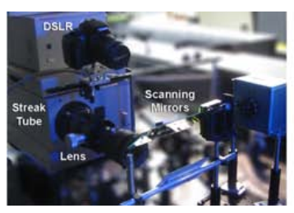
Femto-photography System

Slide 9
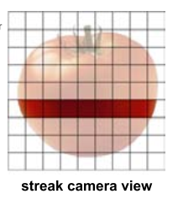
Femto-photography System

Slide 10
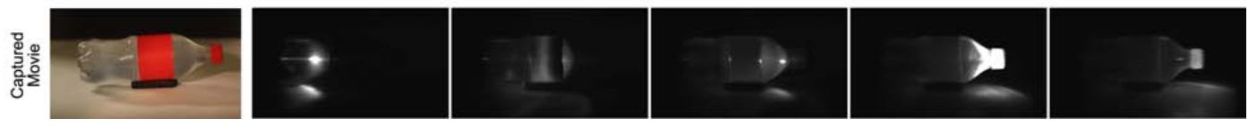
What can we see

Slide 11
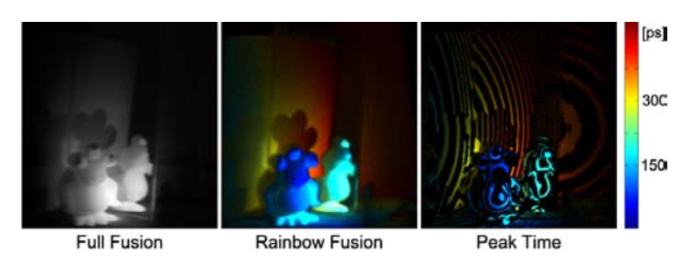
What can we see

Slide 12
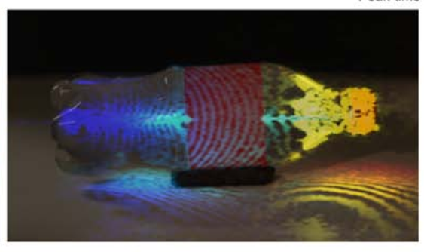
What’s abnormal

Slide 13
What’s abnormal

Slide 14
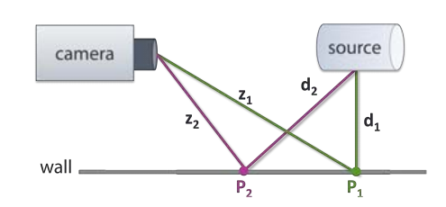
Time Unwarping

Slide 15
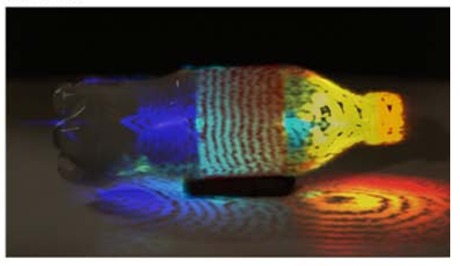
Time-Unwarped Image

Slide 16
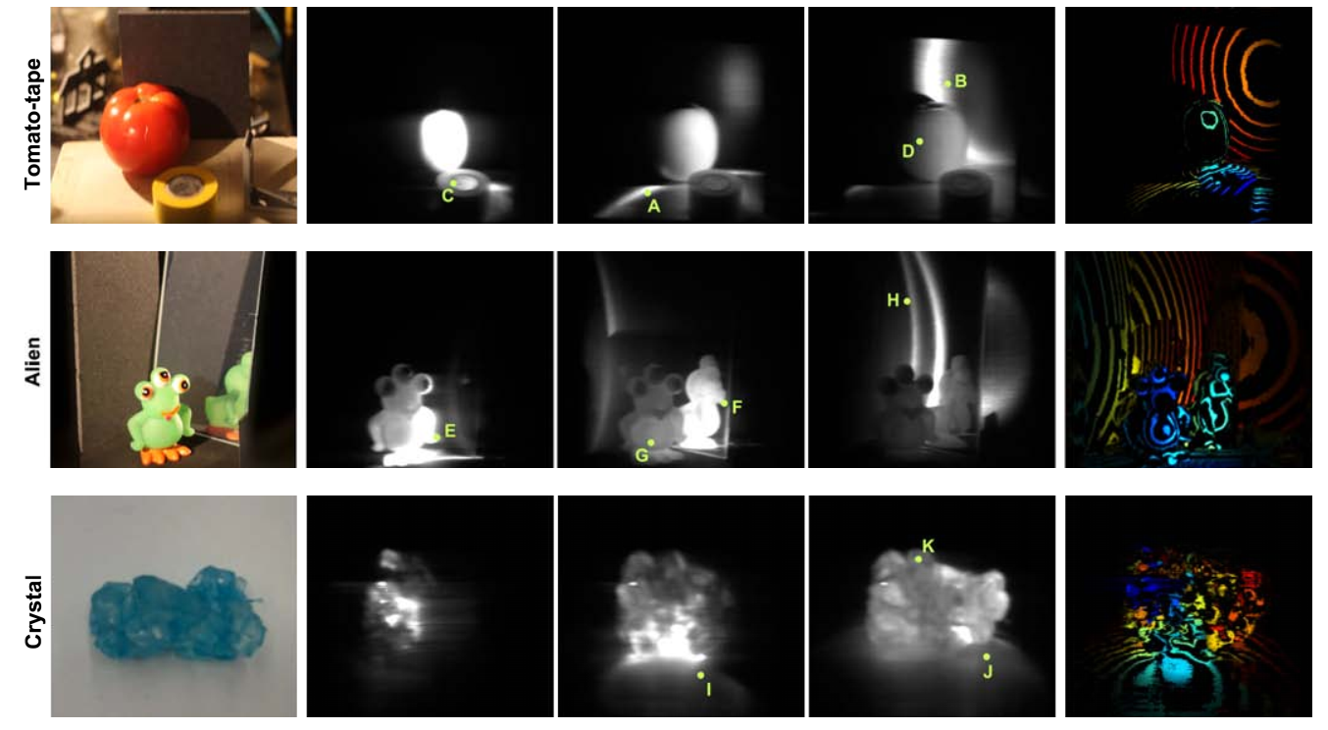
More results

Slide 17
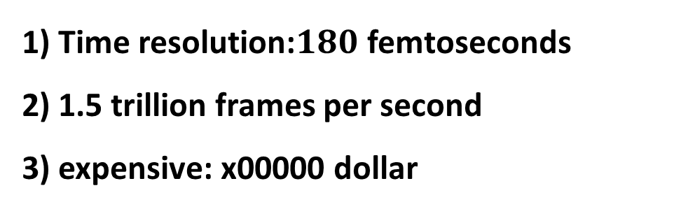
Streak camera
1) Time resolution:$180$ femtoseconds
2) 1.5 trillion frames per second
3) expensive: x00000 dollar
Notes:
光子马赫锥”和神经元激发（neurons fire
2011年12月，麻省理工学院的一个团队发布了结合使用条纹相机和重复激光脉冲的图像，模拟出每秒一万亿帧的电影。[6] 2020年，加州理工学院的一个团队超越了这个数字，实现了每秒70万亿帧的帧率。）

Slide 18
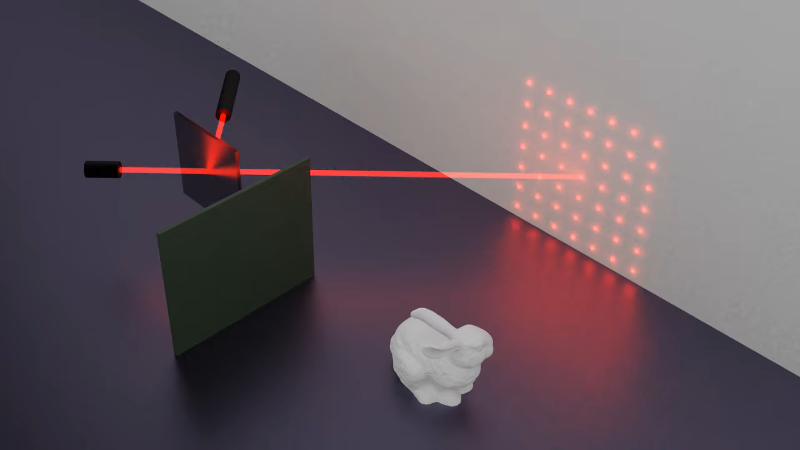
Here comes NLOS
Notes:
量子力学与相对论

Slide 19
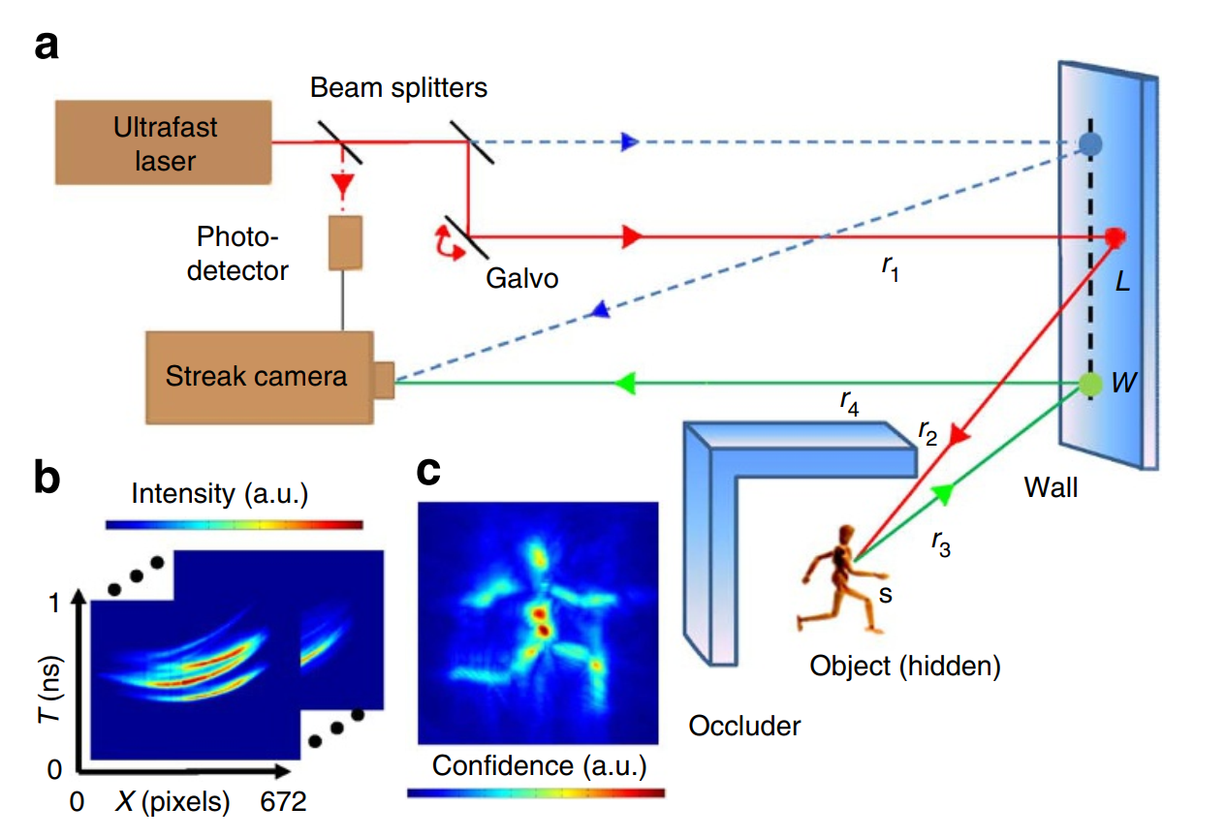
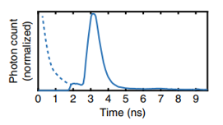
The first NLOS
d
[2] Velten, Andreas, et al. "Recovering three-dimensional shape around a corner using ultrafast time-of-flight imaging." Nature communications 3.1 (2012): 1-8.
Notes:
量子力学与相对论

Slide 20
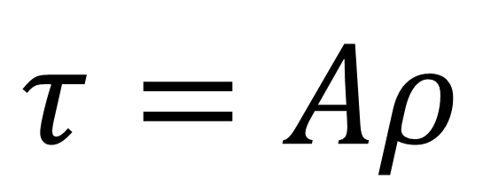
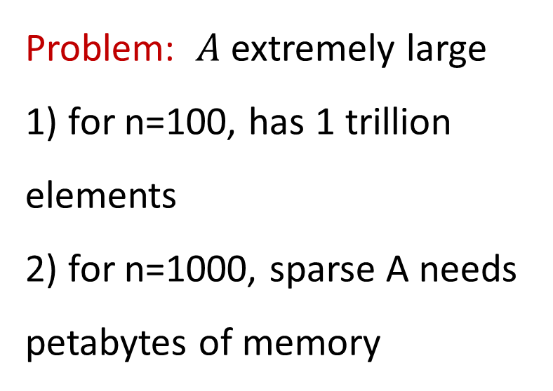
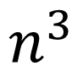
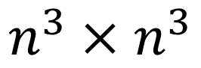
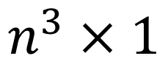
Why NLOS difficult
$$n^{3}$$
Unknown volume
Problem: $A$extremely large
1) for n=100, has 1 trillion elements
2) for n=1000, sparse A needs petabytes of memory
$$τ=Aρ$$
measurements
Transport matrix
$$n^{3}×1$$
$$n^{3}×n^{3}$$

Slide 21
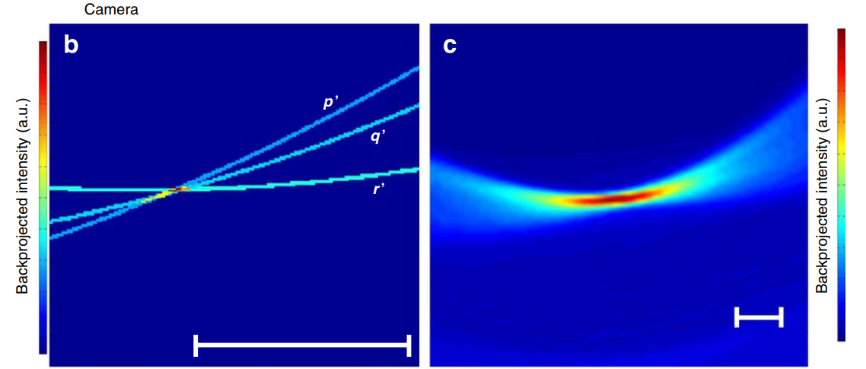
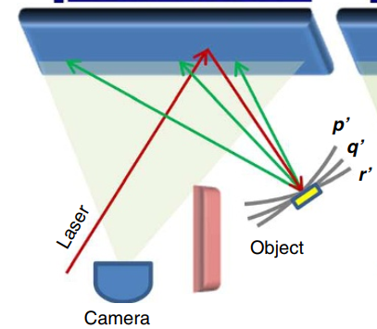
FBP for NLOS
Notes:
量子力学与相对论

Slide 22
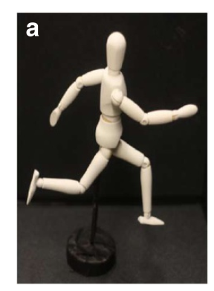
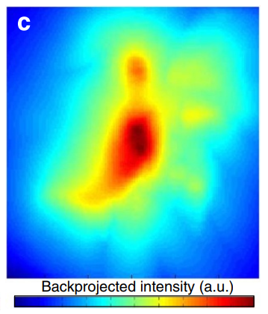
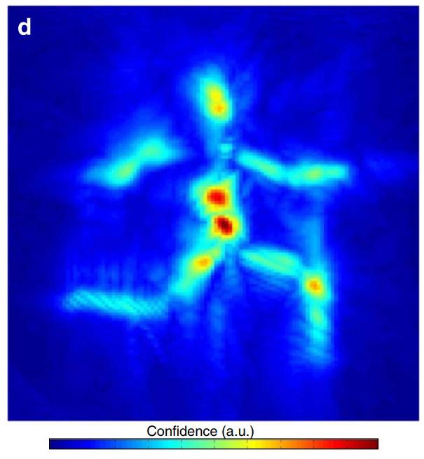
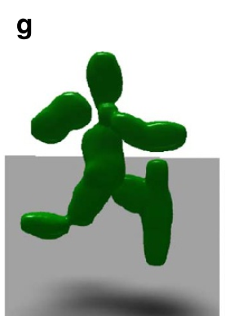
FBP for NLOS
Notes:
量子力学与相对论

Slide 23
FBP for NLOS
Process:
Set bounding box
FBP
Re-set bounding box and repeat
Using Laplace kernel
Notes:
量子力学与相对论

Slide 24
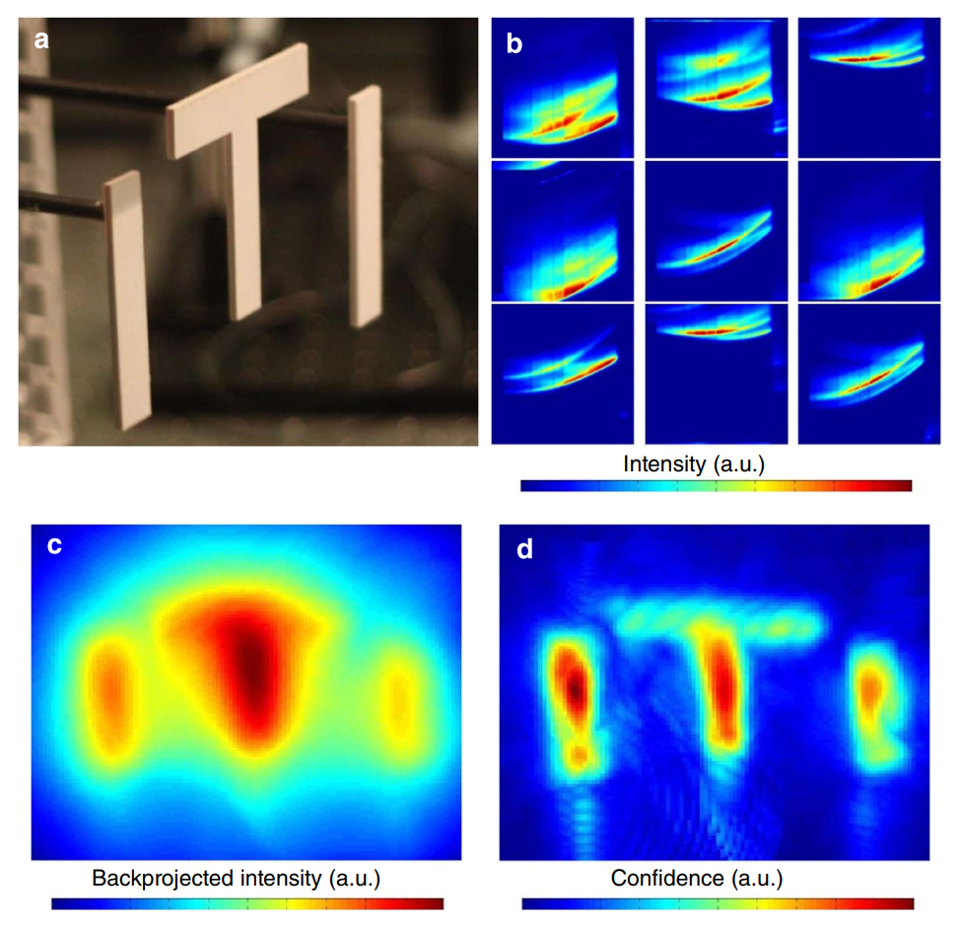
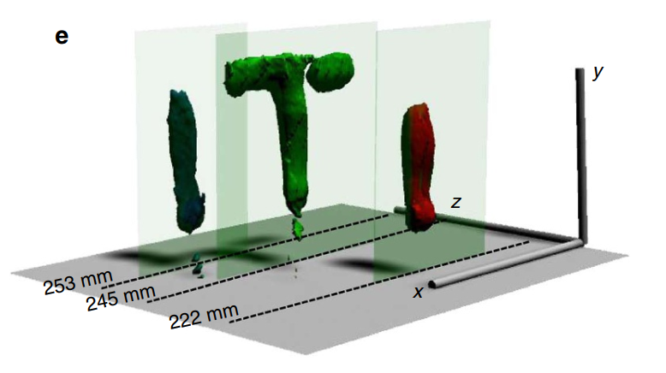
FBP for NLOS
Notes:
量子力学与相对论

Slide 25
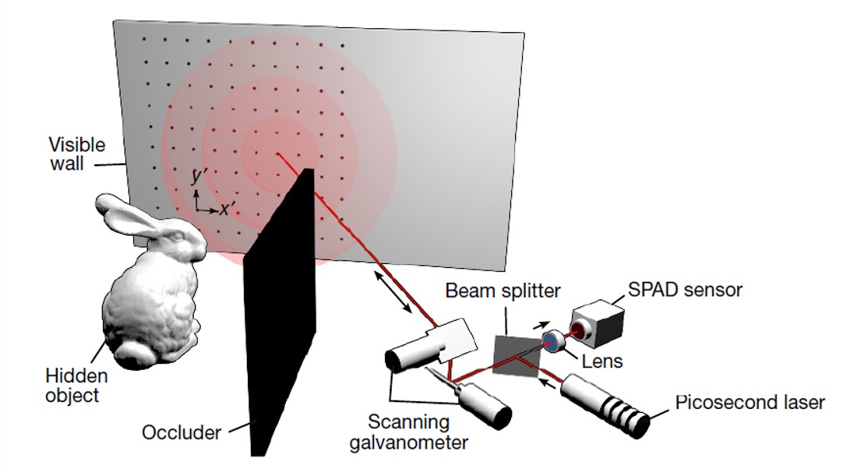
The first con-focal NLOS
Contribution:
1) Confocal NLOS
2) Light Cone Transform
Assumption:
1) Isotropic scattering (only diffuse or retroreflective objects)
[3] O’Toole, Matthew, David B. Lindell, and Gordon Wetzstein. "Confocal non-line-of-sight imaging based on the light-cone transform." Nature 555.7696 (2018): 338-341.
Notes:
这篇文章的重点主要有两点。一点是LCT第一次正式提出了confocal的NLOS这一setting。
还有就是light cone transform 这一核心方法。这一方法能够为解决NLOS的这一inverse problem提供一种效果较好且速度较快且memory efficienct的方法。

Slide 26
Here comes NLOS
Notes:
量子力学与相对论

Slide 27
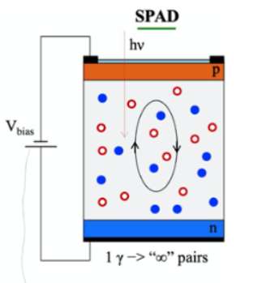
Single-photon avalanche diode
Notes:
SPAD是PN结工作在Geiger模式下，这种模式下p-n结反向偏置电压在击穿电压(Break Down)之上。当一个光子被半导体的耗尽区吸收时，它会产生一个电子-空穴对，这个电子-空穴对在电场的作用下分裂和加速。如果电子或空穴的能量足够高，撞击电离就会产生更多的电子-空穴对，引发自我维持的雪崩。当电场强度高于材料的临界场时，载流子的撞击电离就会发生这种雪崩现象。在硅中，临界场Ecr≈3×105v /cm。通常一旦雪崩开始一股毫安级的大电流就会流经设备，直到它被摧毁。如下图,因此一般会使用电阻Rq与SPAD串联防止烧毁的情况.这种电阻通常是千欧姆的量级.并行当V-A的阳极电压向过量偏置电压V-EB增加时，它通过将电流降低到小于100 μA 的方式来抑制(quenching )雪崩。抑制(quenching )完成后，开始充电过程，使像素回到空闲模式,进入下一个周期。

Slide 28
Single-photon avalanche diode
Time resolution: 16ps
Advantage: cheaper
Problem: noise
Notes:
SPAD是PN结工作在Geiger模式下，这种模式下p-n结反向偏置电压在击穿电压(Break Down)之上。当一个光子被半导体的耗尽区吸收时，它会产生一个电子-空穴对，这个电子-空穴对在电场的作用下分裂和加速。如果电子或空穴的能量足够高，撞击电离就会产生更多的电子-空穴对，引发自我维持的雪崩。当电场强度高于材料的临界场时，载流子的撞击电离就会发生这种雪崩现象。在硅中，临界场Ecr≈3×105v /cm。通常一旦雪崩开始一股毫安级的大电流就会流经设备，直到它被摧毁。如下图,因此一般会使用电阻Rq与SPAD串联防止烧毁的情况.这种电阻通常是千欧姆的量级.并行当V-A的阳极电压向过量偏置电压V-EB增加时，它通过将电流降低到小于100 μA 的方式来抑制(quenching )雪崩。抑制(quenching )完成后，开始充电过程，使像素回到空闲模式,进入下一个周期。

Slide 29
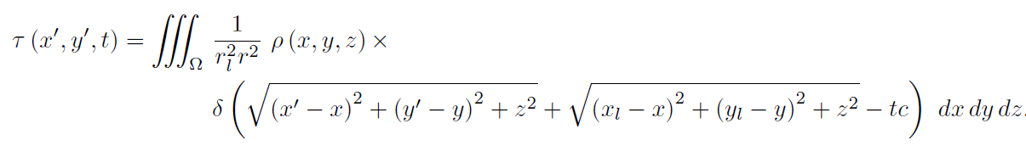
Confocal NLOS
Non confocal

Slide 30
Confocal NLOS
Non confocal
Confocal

Slide 31
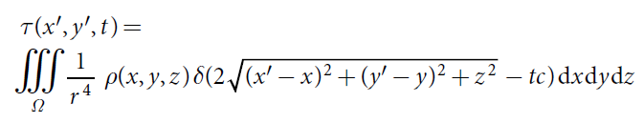
Light Cone Transform

Slide 32
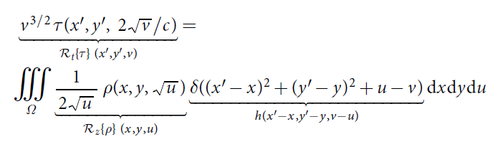
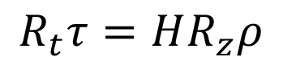

Light Cone Transform
Let $z=\sqrt{u} and$ use
We can get:
Discretize:
$$R_{t}τ=HR_{z}ρ$$

Slide 33
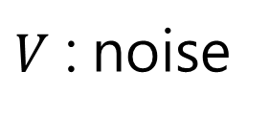
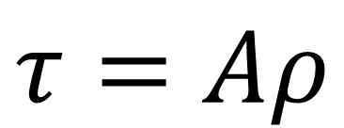
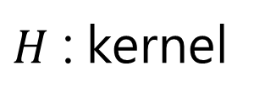
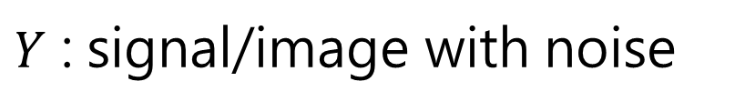
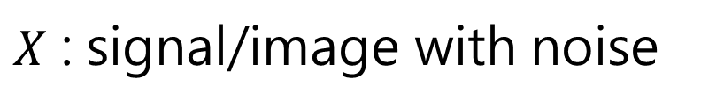
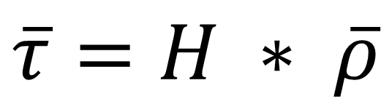
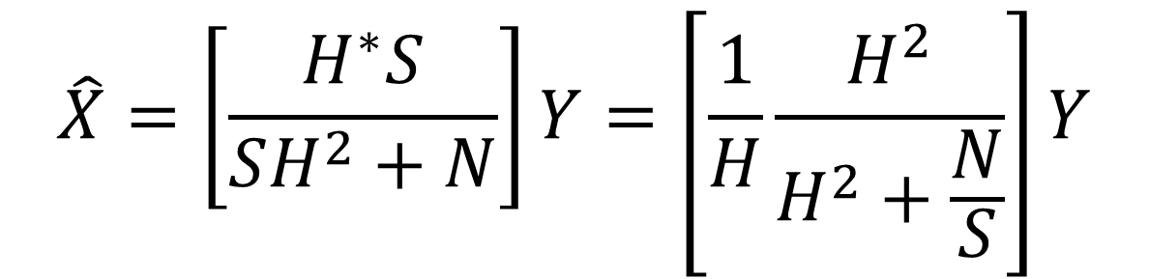
Why con-focal
$$τ=Aρ$$
$$\overline{τ}=H ∗ \overline{ρ}$$
Simplified NLOS:
Wiener Filter:
$$Y\left(u,v\right)=H\left(u,v\right)X\left(u,v\right)+V(u,v)$$
$Y$ : signal/image with noise
$H$ : kernel
$X$ : signal/image with noise
$V$ : noise
$$\hat{X}=\left[\frac{H^{∗}S}{SH^{2}+N}\right]Y=\left[\frac{1}{H}\frac{H^{2}}{H^{2}+\frac{N}{S}}\right]Y$$

Slide 34
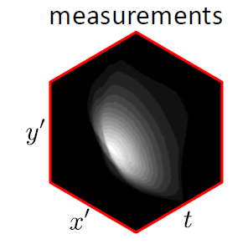
Light Cone Transform

Slide 35
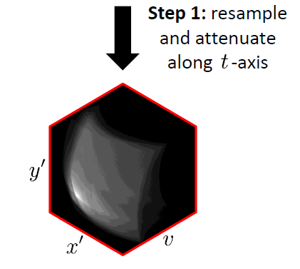
Light Cone Transform

Slide 36
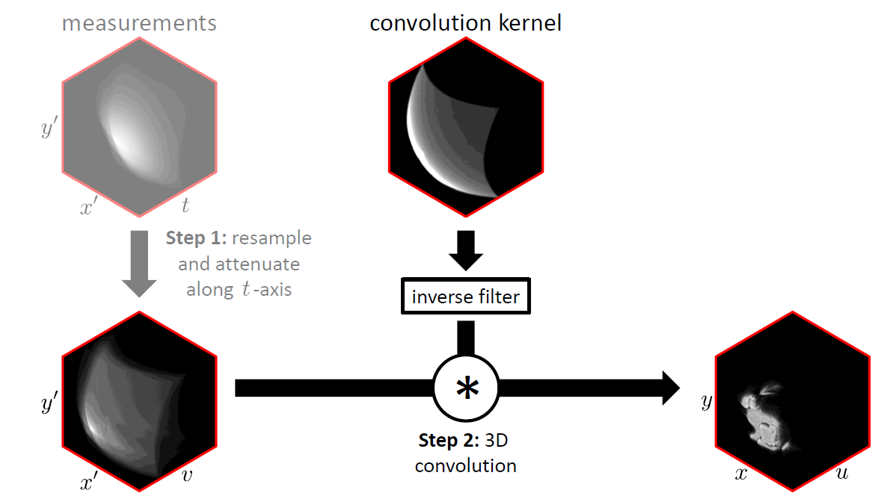
Light Cone Transform

Slide 37
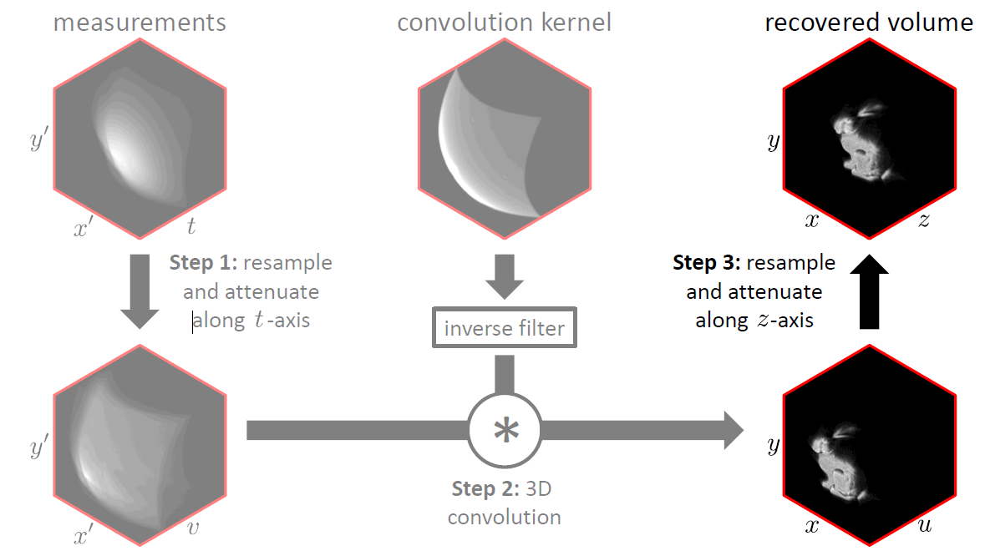
Light Cone Transform

Slide 38
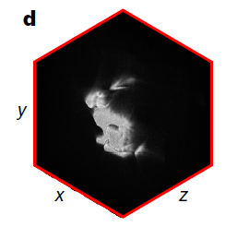
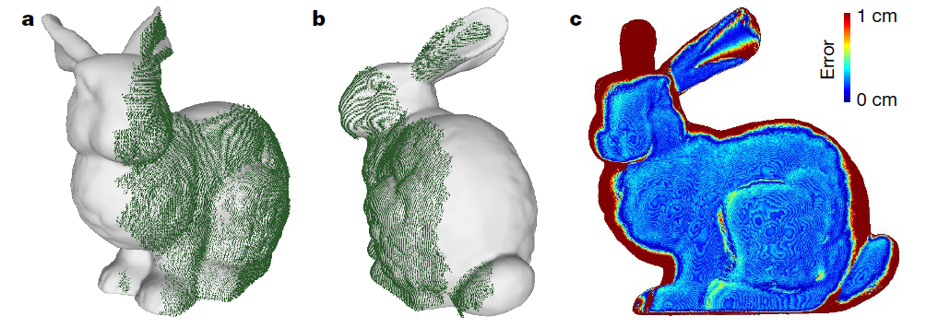
Result

Slide 39
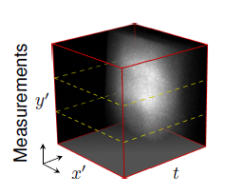


Result

Slide 40



Result

Slide 41

D-LCT
[4] Young, Sean I., et al. "Non-line-of-sight surface reconstruction using the directional light-cone transform." Proceedings of the IEEE/CVF Conference on Computer Vision and Pattern Recognition. 2020.
Notes:
2020 CVPR

Slide 42

D-LCT
1) More accurate forward model with Lambert cosine law
2) Enables recovery of surface normals
Notes:
2020 CVPR

Slide 43

Result
Notes:
2020 CVPR

Slide 44


Result
Notes:
2020 CVPR

Slide 45

Result
Notes:
2020 CVPR

Slide 46

F-K
[6] Lindell, David B., Gordon Wetzstein, and Matthew O'Toole. "Wave-based non-line-of-sight imaging using fast fk migration." ACM Transactions on Graphics (ToG) 38.4 (2019): 1-13.
Notes:
2020 CVPR

Slide 47

F-K
Notes:
2020 CVPR

Slide 48

F-K
$$\text{Ψ}\text{(}\text{x}\text{,}\text{y}\text{,}\text{z}\text{=0,}\text{t}\text{) => }\text{Ψ}\text{(}\text{x}\text{,}\text{y}\text{,}\text{z}\text{,}\text{t}\text{=0}\text{)}$$
Notes:
2020 CVPR

Slide 49
F-K
Algorithm:
Fast and memory efficient
Robust to specular and other complex reflectance properties
System:
Pulse Width: 30.6ps(200ps) -> 35ps(70ps)
Power: 0.11mW -> 1W (500mW)
System-wall distance: 2m -> about 4m
Object size: 0.76m * 0.51m -> about 1m * 1m
Notes:
2020 CVPR

Slide 50

specular
Notes:
2020 CVPR

Slide 51

specular
Notes:
2020 CVPR

Slide 52

Result
Notes:
2020 CVPR

Slide 53

Phasor field
[7] Liu, Xiaochun, et al. "Non-line-of-sight imaging using phasor-field virtual wave optics." Nature 572.7771 (2019): 620-623.
Notes:
2020 CVPR

Slide 54

Phasor field
Notes:
2020 CVPR

Slide 55
Phasor field
System:
Pulse Width: 35ps(70ps) -> 35ps(65ps)
Time bin: 16ps -> 4ps
Non-confocal
Notes:
2020 CVPR

Slide 56

Phasor field
Notes:
2020 CVPR

Slide 57

Fermat
[5] Xin, Shumian, et al. "A theory of Fermat paths for non-line-of-sight shape reconstruction." Proceedings of the IEEE/CVF Conference on Computer Vision and Pattern Recognition. 2019.
Notes:
2020 CVPR

Slide 58


Space carving
[8] Kutulakos, Kiriakos N., and Steven M. Seitz. "A theory of shape by space carving." International journal of computer vision 38.3 (2000): 199-218.
Notes:
2020 CVPR

Slide 59

Space carving in NLOS
Notes:
2020 CVPR

Slide 60

Fermat path in NLOS
Notes:
2020 CVPR

Slide 61

Fermat path in NLOS
Notes:
2020 CVPR

Slide 62

Fermat path in NLOS
Notes:
2020 CVPR

Slide 63


Neural reconstruction
[7] Grau Chopite, Javier, et al. "Deep non-line-of-sight reconstruction." Proceedings of the IEEE/CVF Conference on Computer Vision and Pattern Recognition. 2020.
Notes:
2020 CVPR

Slide 64

Neural reconstruction
Notes:
2020 CVPR

Slide 65

Neural reconstruction
Notes:
2020 CVPR

Slide 66
Neural reconstruction
Problem:
Heavy memory cost
Inflexibility
Notes:
Confocal nonconfoacl

Slide 67
Neural reconstruction
Here comes NeRF
Notes:
2020 CVPR

Slide 68

NeTF
[8] Shen, Siyuan, et al. "Non-line-of-sight imaging via neural transient fields." IEEE Transactions on Pattern Analysis and Machine Intelligence 43.7 (2021): 2257-2268.
Notes:
2020 CVPR

Slide 69



Problem Definition
DLCT
DLCT [Young 20]
Limitations:
Fixed reconstruction resolution
Assumptions on material
Phasor Field
Phasor Field [Liu 19]
F-K Migration
F-K [Lindell 19]
Notes:
There are some limitations in current methods. First the resolution of the reconstruction scenes is fixed. Most methods divide the entire space into fixed voxels based on the resolution of the input data. Some methods also limit the material of the reconstructed objects. In order to overcome these limitations, we present a novel volumetric NLOS imaging framework.

Slide 70













From NeRF to NeTF: NLOS Imaging
Spatial location in cartesian coordinate
Scanning point location
MLP
$$(x^{′},y^{′};r,θ,φ)$$
$$(x,y,z,θ,φ)$$
$$(x,y,z,θ,φ)$$
Residual
Spatial location
Transient rendering
sampling
Transients
$$(σ,ρ)$$
Color
Density
density
albedo
sampling
$$c$$
$$σ$$
volume rendering
Predicted transients
$$σ$$
$${Loss=\left\| − \right\|}_{2}^{2}$$
$$c_{Pred}$$
$$c_{GT}$$
$$distance$$
Notes:
Now, Let’s move on to see how we establish our neural transient fields.
First, Instead of on a line, we sample on a spherical wavefront. Then We parameterize every point under spherical coordinates. It facilitates sampling and derivation of volume rendering. However, recall that NLOS system needs to scan different spots on the relay wall, it will lead to inconsistence of spherical coordinates for the same location in the space. It will also cast challenges in network training and inference. So, We need to first transform them to their corresponding Cartesian coordinates. A multilayer perceptron takes them as input and outputs density and view dependent albedo inferences. We want to mention that the view dependent albedo enables the framework to reconstruct different materials. We then propose our transient rendering technique to predict the transient and use the difference between the predicted and real transient to optimize the multilayer perceptron.

Slide 71

Problem Formulation under NeTF
MLP
Transient rendering
Predicted
transients
$$(σ,ρ)$$
Number of particles
reflectivity of particles
Notes:
Now let's take a closer look at our transient rendering technique. Our rendering model considers the density as the number of Elementary particles in space and albedo as the reflectivity of them in a certain direction.

Slide 72



Propagation in Space
Propagation:
$$dE=−AσEdr$$
density
Reflectance:
$$E′=ρ∙E$$
albedo
Notes:
In this way, The energy change of the wavefront with its propagation in space comes from the absorption and reflectance by particles.

Slide 73


Transient Rendering Forward Model
$$τ\left(x^{′},y^{′},t\right)=Γ_{0}\iint_{H(x^{′},y^{′};ct/2)}{\frac{sinθ}{r^{2}}σ∙ρ∙e^{2\int_{0}^{r}{−Aσ\left(r,θ,φ;x^{′},y^{′}\right)dr^{′}}} dθdφ}$$
hemisphere
Notes:
So the transient at each moment is the integral of the contributions of all particles on the hemisphere corresponding to the detection point. By solving the first order differential equation, we can derive the complete transient rendering model. However, the computational cost of such a formula is very large.

Slide 74



Simplify the Forward Model
$$τ\left(x^{′},y^{′},t\right)=Γ_{0}\iint_{H(x^{′},y^{′};ct/2)}{\frac{sinθ}{r^{2}}σ∙ρ }$$
$$∙e^{2\int_{0}^{r}{−Aσ\left(r,θ,φ;x^{′},y^{′}\right)dr^{′}}}$$
$$dθdφ$$
attenuation coefficient
Notes:
It mainly comes from the Attenuation coefficient. So, if we assume that the NLOS scene is all opaque and does not exhibit self-occlusions, we remove the attenuation item to simplify the fromulation, . In our experiment, we found that this formula is sufficient to get a good reconstruction result for most NLOS scenes.

Slide 75




Integral Calculation
$$τ\left(x^{′},y^{′},t\right)=Γ_{0}\iint_{H(x^{′},y^{′};ct/2)}{\frac{sinθ}{r^{2}}σ∙ρ }$$
$$dθdφ$$
Uniformly sampled $(θ,φ)$
$$τ\left(x^{′},y^{′},t\right)=\frac{∆θ∆φ}{r^{2}}\sum_{i,j}{sinθ_{ij}σ\left(r,θ_{ij},φ_{ij};x^{′},y^{′}\right)σ\left(r,θ_{ij},φ_{ij};x^{′},y^{′}\right)}$$
Notes:
Here we show how to numerically compute the continuous integral with uniformly sampled $\theta,\phi$.

Slide 76
From NeRF to NeTF: NLOS Imaging
MLP
$$(x^{′},y^{′};r,θ,φ)$$
$$(x,y,z,θ,φ)$$
Residual
Transient rendering
Transients
$$(σ,ρ)$$
sampling
density
albedo
Predicted transients

Slide 77
Training and Optimization
MLP
Residual
Predicted transients
Transients
Notes:
Now let’s see how we optimize our neural transient field.

Slide 78
Training and Optimization
Photon
count
Photon
count
t
t
measurement from data
predicted measurement
$$loss={|\left|τ_{m}\left(x^{′},y^{′},t\right)−τ\left(x^{′},y^{′},t\right)\right||}^{2}$$
Two-stage training
Hierarchical sampling
Notes:
We use the L2 norm between the captured and predicted measurement as loss function. In every training batch, we use a 1D histogram from the whole 3D data. However, different from Nerf, In NLOS, SPAD only captures a sparse set of spots on the wall. So we proposed two training strategies in order to improve results. First, lets see how we deal with the training bias with two stage training.

Slide 79



Two–stage Training
Imbalanced visibility
Loss distribution
Notes:
We use a bunny for an example. Because of self-occlusion, bunny's right ear can only be observed by scanning points in the upper left corner of the wall. This means that the points on the wall are not uniform for the observation of the scene.
We show the loss distribution of the scanning points after we equally train the data. We can see the loss in the upper left corner is obviously larger than other spots. So The histogram with higher loss should be more fully trained in the following training.

Slide 80



Two–stage Training
Resample
MCMC
$$τ$$
$$τ^{′}$$
Loss distribution
More balanced distribution
First stage
Second stage
Notes:
Therefore, we propose that after a uniform training in the first stage, we resample the data according to the loss distribution with Monte Carlo Markov Chain. And Then we use the resampled data for the second stage training. The more balanced loss distribution will speed up network convergence and improve the result.

Slide 81
Training and Optimization
Photon
count
Photon
count
t
t
measurement from data
predicted measurement
$$loss={|\left|τ_{m}\left(x^{′},y^{′},t\right)−τ\left(x^{′},y^{′},t\right)\right||}^{2}$$
Two-stage training
Hierarchical sampling
Notes:
now, let’s look at hierarchical sampling.

Slide 82


Hierarchical Sampling
Coarse uniform sampling
$$τ\left(x^{′},y^{′},t\right)=\frac{ΔθΔφ}{r^{2}}\sum_{i,j}{sin⁡(θ_{ij})σ\left(r,θ_{ij},φ_{ij} \right)ρ(r_{ij},θ_{ij},φ)}$$
Notes:
Recall that we uniformly sample the hemisphere at each moment to calculate transient. This does not take full advantage of our continuous scene representation. The main idea of Hierarchical samoling is that The density of the uniform sampled points shows where objects are more likely to exist in space. So we propose that every time after a uniform sampling, we perform a non-uniform sampling based on the density map.

Slide 83

Hierarchical Sampling
Fine sampling based on MCMC
$$τ\left(x^{′},y^{′},t\right)=\frac{1}{r^{2}}\sum_{i,j}{\frac{sin⁡(θ_{ij})σ\left(r,θ_{ij},φ_{ij} \right)ρ(r_{ij},θ_{ij},φ)}{K(θ_{f,ij},φ_{f,ij})}}$$
Notes:
In this way, the points with higher density can be more fully sampled and trained. Here we shows how to numerically calculate the transient with ununiform sample points

Slide 84

NeTF results
Notes:
2020 CVPR

Slide 85

NeTF results
Notes:
2020 CVPR

Slide 86

Results on Self-occluded Object
Notes:
To further test the robustness of Neural transient field on occlusions, we experiment on a semi-occluded scene from ZNLOS dataset. Phasor Field is
most sensitive to occlusions. We could see that our method produces sharper edges of both front and back planes.

Slide 87

Our Capture System
Notes:
We also build our own capture system.

Slide 88

NeTF results
Notes:
2020 CVPR

Slide 89
Contributions
A novel neural modeling framework for NLOS imaging.
A forward model under spherical coordinate system.
Two-stage training and hierarchical sampling to improve performance.
MLP
Notes:
To summarize, we present a novel neural modeling framework called Neural transient fields for NLOS imaging using a multi-layer perceptron. Due to the property of light propagation in NLOS, We formulate the systm under spherical coordinates. We also propose two training strategies to improve performance,.
We believe that Neural transient fields demonstrates that deep learning provides an alternative and potentially feasible solution to a broader class of inverse imaging problems.

Slide 90

What else can NLOS do？
[9] Li, Zheng-Ping, et al. "Single-photon computational 3D imaging at 45 km." Photonics Research 8.9 (2020): 1532-1540.
Notes:
浦东民航大厦

Slide 91

What else can NLOS do？
[9] Li, Zheng-Ping, et al. "Single-photon computational 3D imaging at 45 km." Photonics Research 8.9 (2020): 1532-1540.
Notes:
K11购物艺术中心

Slide 92

What else can NLOS do？
[10] Wu, Cheng, et al. "Non–line-of-sight imaging over 1.43 km." Proceedings of the National Academy of Sciences 118.10 (2021): e2024468118.
Notes:
K11购物艺术中心

Slide 93

What else can NLOS do？
[10] Wu, Cheng, et al. "Non–line-of-sight imaging over 1.43 km." Proceedings of the National Academy of Sciences 118.10 (2021): e2024468118.
Notes:
K11购物艺术中心

Slide 94

What else can NLOS do？
[11] Liu, et al. "HiddenPose: Non-Line-of-Sight 3D Human Pose
Estimation."
Notes:
K11购物艺术中心

Slide 95

What else can NLOS do？
[12] Metzler, Christopher A., David B. Lindell, and Gordon Wetzstein. "Keyhole imaging: non-line-of-sight imaging and tracking of moving objects along a single optical path." IEEE Transactions on Computational Imaging 7 (2020): 1-12.

Slide 96

What else can NLOS do？
[13] Lindell, David B., and Gordon Wetzstein. "Three-dimensional imaging through scattering media based on confocal diffuse tomography." Nature communications 11.1 (2020): 1-8.
Notes:
K11购物艺术中心

Slide 97

What else can NLOS do？
[14] Cao, Ruizhi, et al. "High-resolution non-line-of-sight imaging employing active focusing." Nature Photonics (2022): 1-7.
Notes:
K11购物艺术中心

Slide 98
Future directions
Faster and more robust algorithm
System with higher resolution
More applications
Notes:
2020 CVPR

